Slide 1




Challenges in Using Conversational AI for Data Science
Bhavya Chopra¹, Ananya Singha², Anna Fariha³, Sumit Gulwani², Chris Parnin², Ashish Tiwari², Austin Z. Henley⁴
¹
²
³
⁴
HILDA ‘25 @ SIGMOD

Slide 2
Can Large Language Models do Data Science?
1
Data Context
Schema
Data distribution
Data format
2
System Context
Query workload
Database configuration
Hardware
3
Domain Expertise
What denotes missing value?
What are valid values?
What outliers are expected?
4
Code Requirement
Is the mechanism required?
Destructive side effect (deletion)
5
Uncertainty
Objectiveness of the task
Risk-level of the task
User trust
Notes:
Large Language Models or LLMs can potentially assist in many of the data management tasks, but they aren’t equally suitable, or natural fit, for all the tasks. It depends on the task, and more specifically, certain properties of a task.
We all use LLMs for data science tasks these days, but their effectiveness depends on several factors.
Some of these are: data context, system context, domain expertise, code requirements, and various uncertainties..
For example, understanding what denotes missing values or valid data often requires domain knowledge that LLMs may lack!

Slide 3
Research Questions
RQ1: User-AI Interaction for Data Science
How do data scientists interact with ChatGPT to complete data-science tasks?
RQ2: Friction Points and Gaps
What challenges and unmet needs do data scientists face when interacting with ChatGPT?
RQ3: Generalizability
How well do these challenges and needs generalize to the broader community of data scientists?
Notes:
Our research focused on three main questions:
How do data scientists interact with ChatGPT for data science tasks? [NEXT]
What challenges and unmet needs arise in these interactions? [NEXT]
How generalizable are these challenges across the broader data science community?

Slide 4



Study Methodology
Study 1: Observational Study
Study 2: Survey Validation
Observe how data scientists engage with LLMs for tasks
Validate the generalizability of qualitative findings with broader community of data scientists
14 data scientists
114 data scientists
Think-aloud, task-based
40–60 minutes per session
Qualitative analysis
Online survey
8 questions
5-point Likert scale
strongly disagree to strongly agree
Notes:
We conducted two studies:
An observational study with 14 data scientists performing real tasks using ChatGPT.
A survey with 114 data scientists to validate and generalize our findings.
The observational study involved think-aloud sessions, while the survey used Likert-scale questions to assess agreement with key findings.

Slide 5
Study 1: Observational Study
Study Tasks
T1: Datetime Typecast (with an atypical format)
T2: Split using Delimiter (in a column with heterogeneously formatted values)
T3: Feature Engineering (deriving a feature and selecting predictors)
T4: Visualization (heatmap plotting)
Time Allocation
64%
Prompt Preparation
27%
Code Adaptation
9%
Validation
Notes:
Diving deeper into the observational study, we had all participants complete four tasks with a 911 calls dataset:
datetime typecasting, splitting columns, feature engineering, and visualization.
Most time was spent on prompt preparation (64%), followed by code adaptation (27%) and validation (9%).

Slide 6
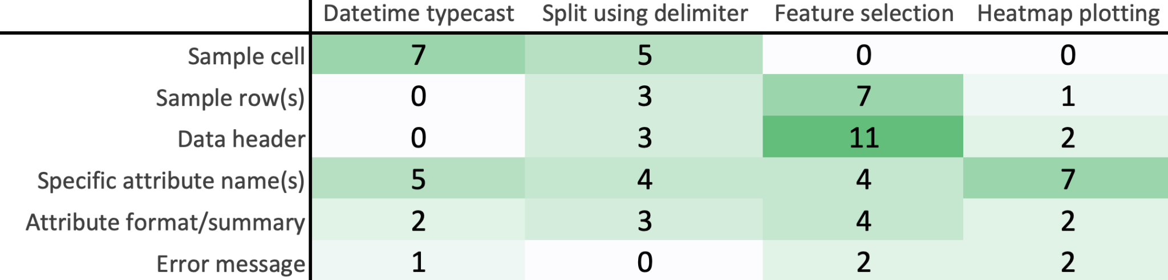
Key Findings: Communication Obstacles
Broken communications with ChatGPT derail data analysis
14/14 participants found it challenging to convey data context and parse LLM assumptions
“
🔄 Context Sharing
10/14 participants struggled with sharing dataset context
Dataset schemas, slices of interest, and domain knowledge of the dataset are hard to communicate
It is all about the context which we provide. If we could refine it, it would do better.
“
I will have to tell the LLM that this column has some problematic missing values and also share sample values.
🧐 Opaque AI Assumptions
📚 Missing Specifications
Notes:
All participants struggled to convey data context and parse LLM assumptions.
Sharing dataset schemas, slices of interest, and domain knowledge was particularly challenging.
Several participants underscored the importance of sharing context (first quote)
At the same time, participants found it hard to communicate which columns had missing or problematic values. (second quote)
The image shows the number of instances where different pieces of data were shared as context with the LLM per task.

Slide 7
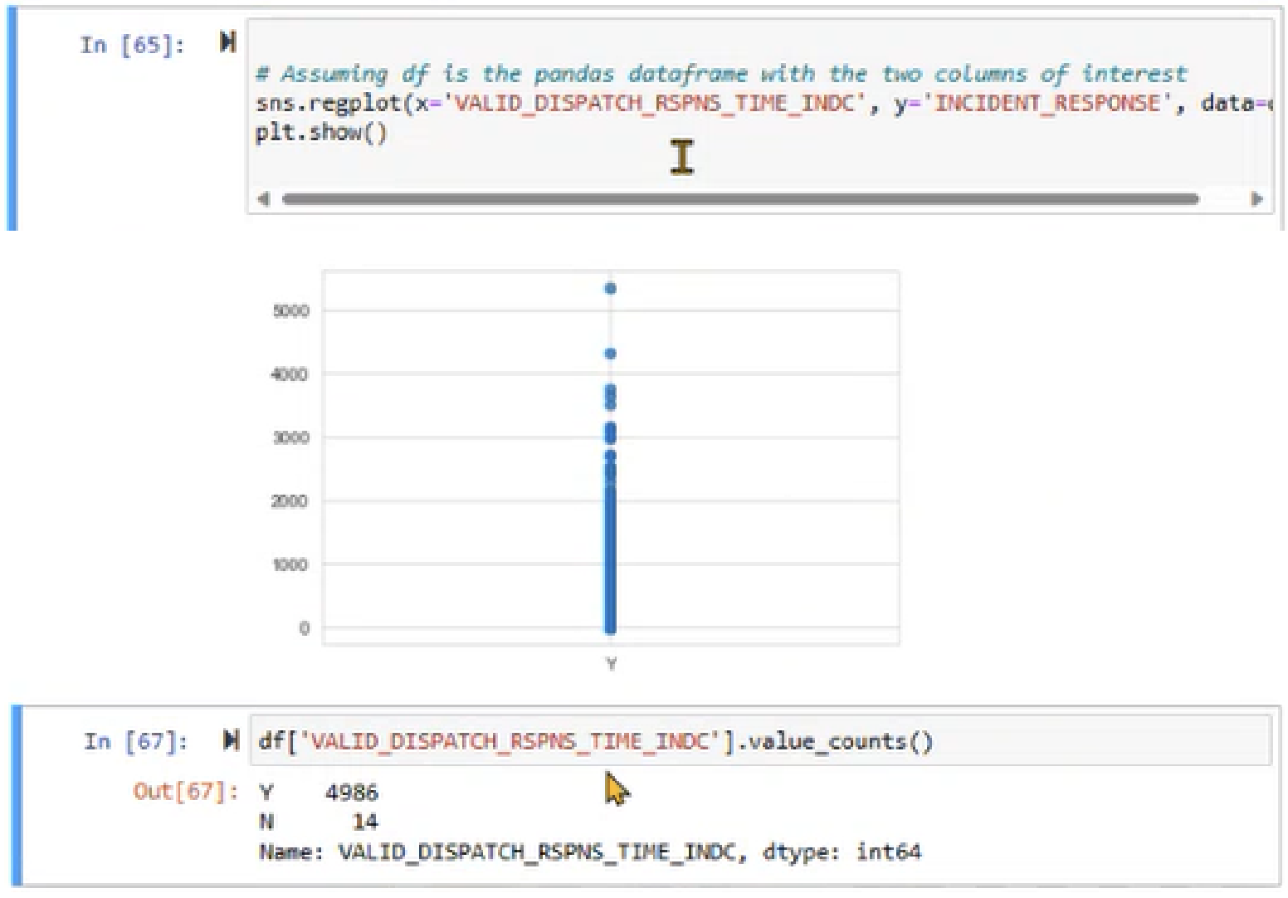
Key Findings: Communication Obstacles
Broken communications with ChatGPT derail data analysis
14/14 participants found it challenging to convey data context and parse LLM assumptions
“
🔄 Context Sharing
Oh, it thinks the call type is int, let me say that it is boolean
🧐 Opaque AI Assumptions
14/14 participants noticed unexpected assumptions
ChatGPT makes implicit decisions about data types, values, formats, and quality
📚 Missing Specifications
Notes:
ChatGPT often made unexpected assumptions about data types, values, and formats.
14 out of 14 participants noticed these implicit decisions, which sometimes led to incorrect or generic responses.
Users had to clarify or override these assumptions repeatedly.
The instance on the right shows how ChatGPT assumed the X variable to be an integer, when it was in fact boolean, leading to ineffective outputs.

Slide 8
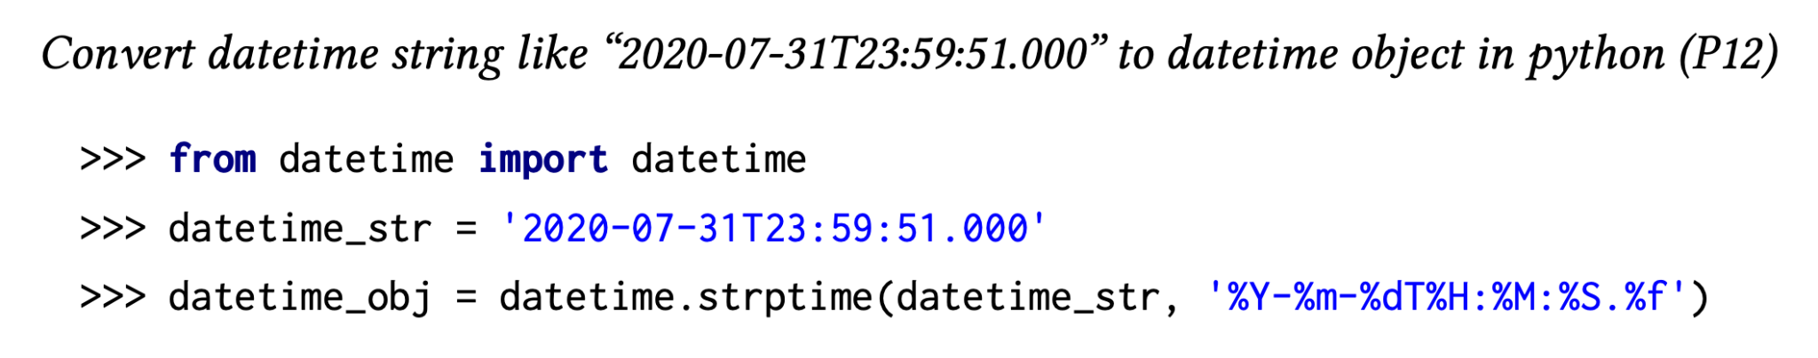
Key Findings: Communication Obstacles
Broken communications with ChatGPT derail data analysis
14/14 participants found it challenging to convey data context and parse LLM assumptions
🔄 Context Sharing
🧐 Opaque AI Assumptions
“
I forgot to mention my pandas dataframe…
So, it suggested strptime() instead of to_datetime()!
📚 Missing Specifications
13/14 participants faced misaligned expectations
Missing specifications in user
prompts lead to generic or incorrect responses
Notes:
13 out of 14 participants faced issues due to missing specifications in their prompts.
This led to misaligned expectations and required users to refine their prompts multiple times.
For instance, not specifying the use of pandas led to suggestions for standard Python libraries and the generation of inefficient (non-vector) code that runs on a row-by-row basis instead.

Slide 9
Key Findings: Code Adaptation Challenges
Repetitive Code Edits Required
13/14 participants needed multiple code modification cycles
🔧 Dataset Schema Mismatches
Generated code assumes different table structures, column names, or data types
📗 Exploratory Code for Notebooks
Refactoring to exploratory code snippets & matching other notebook/data preferences
🐞 Validation and Debugging
Generated queries may not generalize to the entire data and require validation
📊 Visualization Formatting
Charts and plots require manual styling and formatting adjustments
Notes:
As a result of communication obstacles, participants ended up making non-trivial efforts in code adaptations. We observed some repetitive edits across our study sessions:
13 out of 14 participants needed to make multiple code modifications.
Common issues included mismatches in dataset schema
Notebook code and data management preferences (like imports on top, exploratory code (Mary Beth Kery, Brad Myers) instead of well wrapped functions)
and the need for manual validation
and several back and forth iterations for refinement of visualizations.
Generated code often required significant adaptation to fit into existing workflows…

Slide 10
Study 2: Survey Validation
Communication Obstacles
Code Adaptation
Including data context is essential
Generated code needs non-trivial edits
86%
87%
Tedious to assess and fetch relevant context
LLMs lack domain understanding of data
59%
60%
Challenging to prompt for columns with quality issues
Require back-and-forth chats for refinement
62%
92%
Notes:
Next, I will talk about our second study, which was a survey study.
The survey confirmed the generalizability of these challenges:
86% agreed that including data context is essential.
59% found it tedious to fetch relevant context.
62% found it challenging to convey context of data quality issues to the LLM
87% said generated code needed non-trivial edits.
60% respondents said that LLMs lack domain understanding of their data, which leads to non-trivial code modifications
92% needed back-and-forth chats for refinement, especially for visualizations

Slide 11
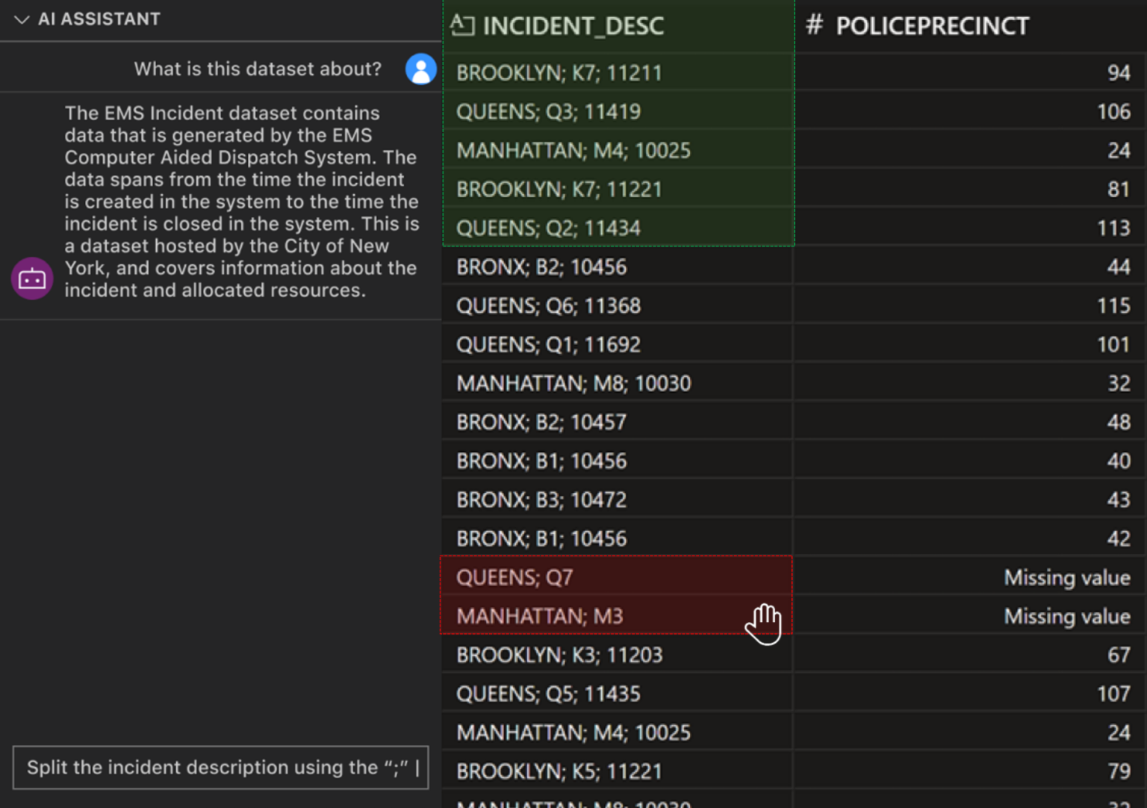

Design Recommendations
Preemptive and Fluid Context
Database systems must surface data characteristics and anomalies preemptively as context for LLMs
Enable users to share context fluidly through techniques like brushing
🤔 Inquisitive Feedback Loops
🛠️ Code Adaptation Support
Data brushing to share context with the LLM
🔍 Transparency and Assumptions
Notes:
The illustration shows how data science tools may enable brushing, letting the user indicate “good” samples in green and “bad” samples in red, directing the LLMs attention to data quality issues and edge cases in their data.
We may also enable in-situ notes and annotations to provide the LLM with enriched context

Slide 12
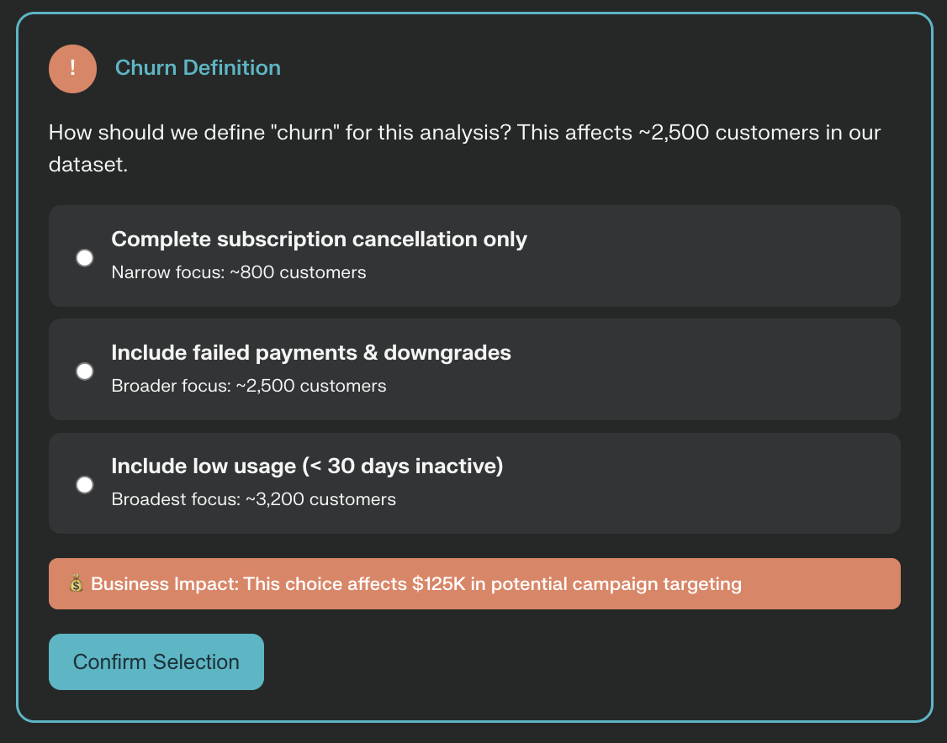
Design Recommendations
Preemptive and Fluid Context
🤔 Inquisitive Feedback Loops
Ask clarifying questions about the data and task preferences
Proactive disambiguation of intent for missing specifications in prompts
Interactive intent eliciting to match user intent
🛠️ Code Adaptation Support
🔍 Transparency and Assumptions
Clarifying questions to elicit user intent and align with their analytical focus
Notes:
The illustration depicts how tools may ask clarifying questions to elicit user intent and align better with their analytical focus instead of making implicit assumptions

Slide 13

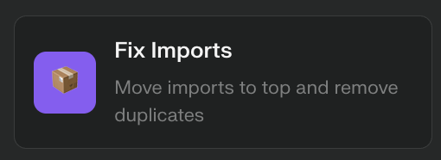

Design Recommendations
Preemptive and Fluid Context
🤔 Inquisitive Feedback Loops
🛠️ Code Adaptation Support
Lightweight program analysis in computational notebooks
Enable behavior-preserving parameter and dataset schema adjustments
Support validation through always-on indicators
Code brushes in computational notebook environments for repetitive edits
🔍 Transparency and Assumptions
Notes:
Here, we illustrate how “code brushes” may help perform repetitive code adaptation tasks like splitting into cells, validating code, fixing imports, adding documentation, etc may save users time. These code brushes can be based on lightweight program analysis techniques and careful LLM enabled behaviour preserving edits.

Slide 14
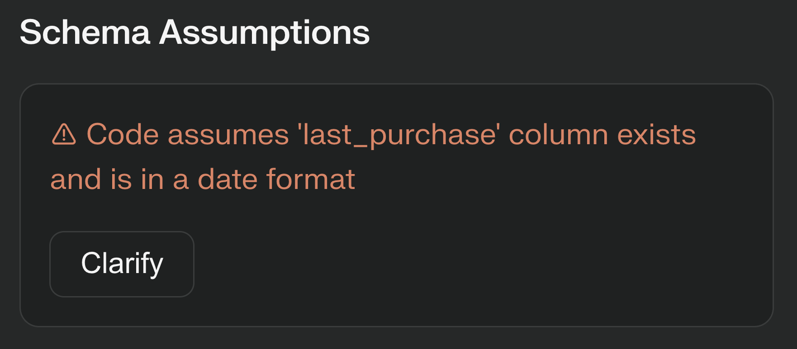
Design Recommendations
Preemptive and Fluid Context
🤔 Inquisitive Feedback Loops
🛠️ Code Adaptation Support
🔍 Transparency and Assumptions
Make LLM assumptions explicit, for both the data and the task
Enable bi-directional transfer of assumptions between users and AI
Enable users to edit shared context and override LLM assumptions
Making LLM assumptions explicit and enabling two-way communication
Notes:
This illustration shows how data science tools can surface LLM assumptions and seek user input to override them

Slide 15
Challenges in Using Conversational AI for Data Science
Thank you!
Questions and Discussion
🎯 Key Takeaways
Context gathering and sharing is a bottleneck (64% time)
Leverage metadata and constraints to reduce ambiguity
Need to support direct manipulation over conversational experiences for refinement
Need for transparency and control for critical adoption
Bhavya Chopra, Ananya Singha, Anna Fariha, Sumit Gulwani, Chris Parnin, Ashish Tiwari, Austin Z. Henley
Notes:
In summary, context gathering and sharing is the key bottleneck in using conversational AI for data science.
Leveraging metadata, supporting direct manipulation for refinement, and increasing transparency are key to improving these experiences.
Thank you, we welcome questions

